Slide 1
Screening for Chronic Kidney Disease Case
IDS-506
Health Information and Management Analytics
Vivek Kumar

Slide 2
The Case
To create an easy-to-use screening tool to identify patients at risk for CKD
Even with wide availability and low cost of a test for CKD, many in the at-risk population have not been tested due to low awareness
With benefits of early detection and treatment of CKD, the need for screening tool is clear
The screening tool shall be able to identify high risk patients (for CKD) with easily obtainable patient data

Slide 3
The Data
Given data has records for 8,819 patients with 34 features for each
6,000 patient records have results of CKD test (Tested Positive/Negative)
The screening model shall be able to identify at-risk CKD patients from records of 2,819 patients not tested for CKD yet
The data has missing values for multiple records, which we need to impute before creating a screening model

Slide 4
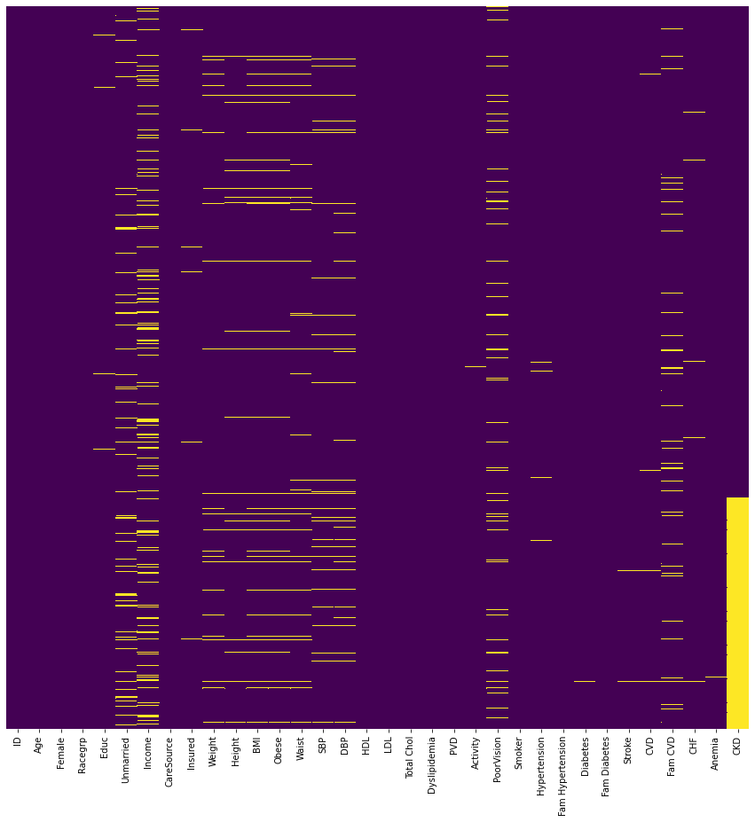
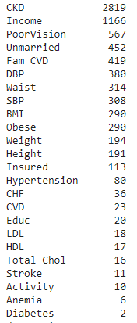
Missing Data

Slide 5
Data Cleaning
Replaced missing values with -9 for the following attributes:
Income, PoorVision, Unmarried, Fam CVD, Insured, Hypertension, CHF, CVD, Educ, Stroke, Anemia, Diabetes
Replaced missing values with mean for the following attributes:
DBP, Waist, SBP, Weight, Height, LDL, HDL, Total Chol
Replaced missing values as Weight(Kg)/Height(m)^2 for BMI
Replaced missing values as 0 and 1 for Obese based on corresponding values of BMI(1 for BMI>30 and 0 for BMI<=30)
Replaced missing values as 2 for Activity
One hot encoding for 'Racegrp','CareSource','Activity'

Slide 6
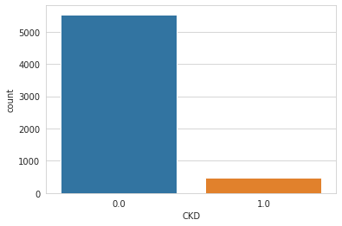
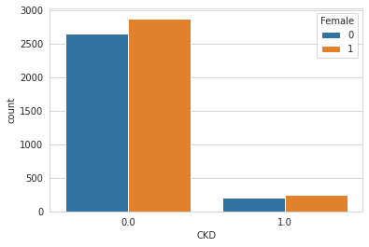
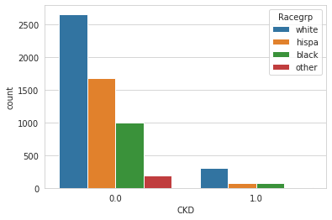
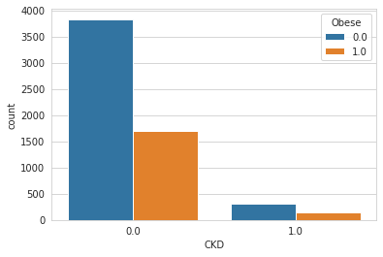
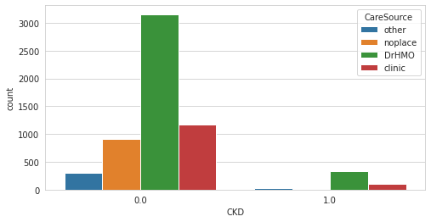
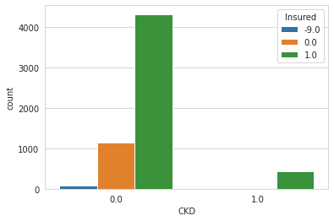
EDA

Slide 7
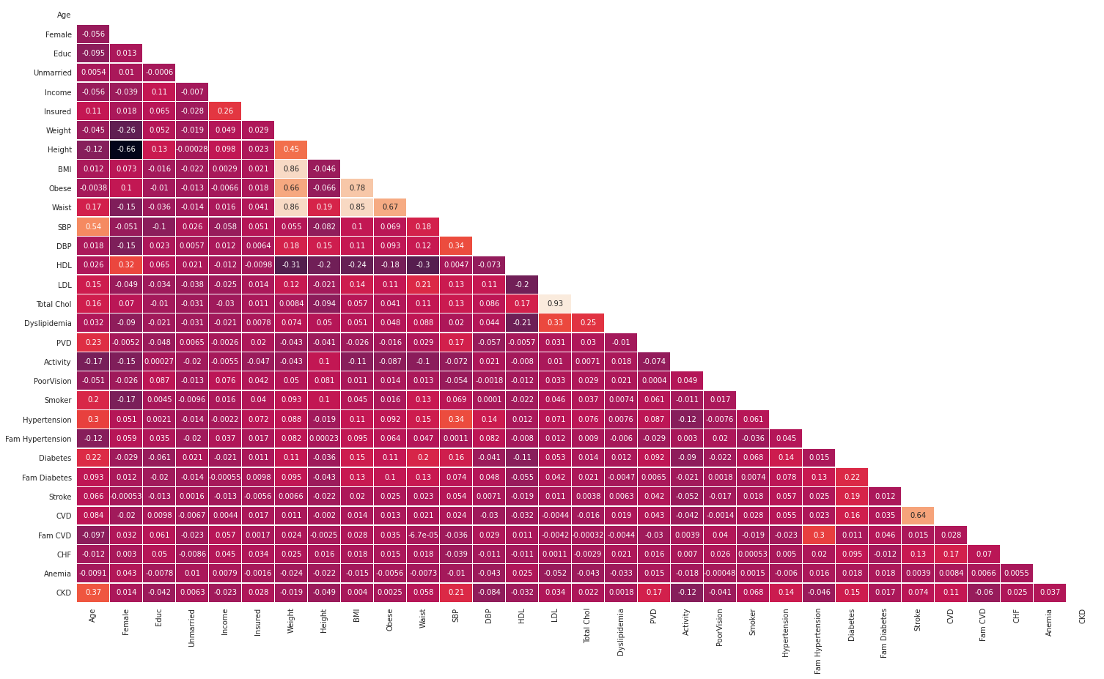
Correlation Plot

Slide 8
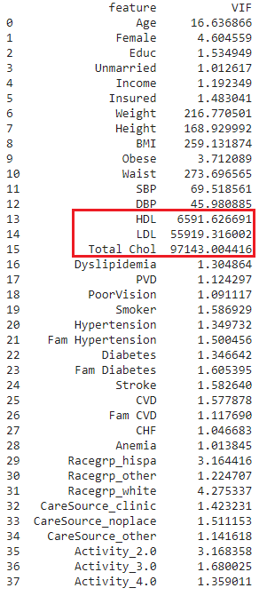
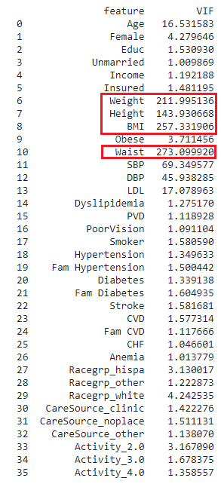
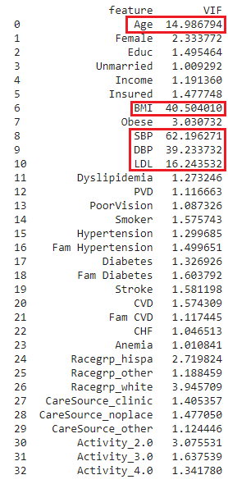
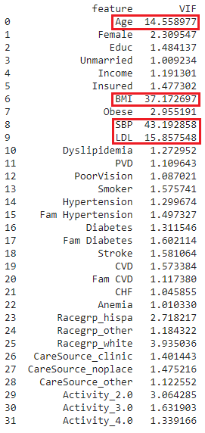
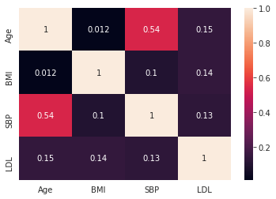
Removing Multicollinearity using Variance Inflation Factor (VIF)
VIF for Original Dataset
Removed HDL & Total Chol
Removed Height, Weight & Waist
Removed DBP
Correlation Plot for Attributes with high VIF

Slide 9
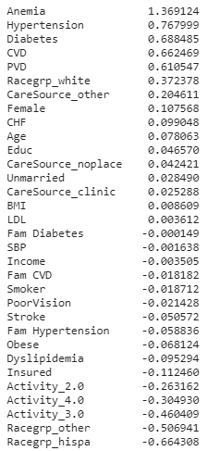
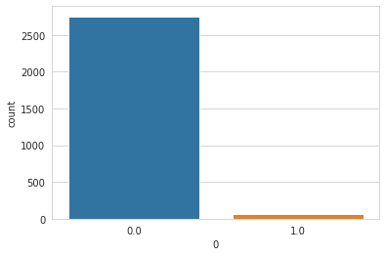
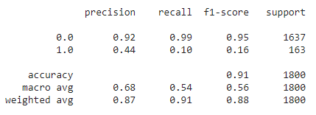
Logistic Regression Model
Feature Importance
Divided the dataset into two segments as CKD results was available only for 6000 records
To evaluate the model performance, further divided the 6000 dataset into train and test data
Identified 65 at-risk for CKD patients who did not take CKD tests out of 2819 patient records

